Slide 1
Lab 5
Database and JSP & Servlet

Slide 2
MySQL
Lab resource: \\10.8.41.100\To-Student
  Lab 5 guide
Other resource: Navicat
Original software resource: download from dev.mysql.com
Is a popular database of many system.
Can do anything as a DBMS does

Slide 3
Step to build DB page with Java
Build database and tables
Build JSP or Servlet pages
Write code to connect to database in that pages
Write code to manipulate data (insert, delete, update, retrieve) in that pages

Slide 4
Build database and tables
Start mySQL by run some tools such as MyAdmin… or mysqld.exe in console window.
Connect to database (use some accounts) by Navicat Lite. Default server running at localhost:3306
Create a database schema
Create tables to contain data
Insert data into table

Slide 5
Build JSP or Servlet pages
Create a JSP or servlet class as normal

Slide 6
Connect to database server
Using JDBC (Java DataBase Connectivity)
  Make reference to package jar file
    MySQL JDBC Driver
Follow by steps:
  Import packages
    Put following code to your program
      import java.sql.*;
  Load the driver (JDBC)
    Code: Class.forName(“com.mysql.jdbc.Driver“);

Slide 7
Connect to database server (cont.)
  Define the connection URL
    String URL = "jdbc:mysql://localhost:3306/weblab5“;
  Establish the connection
    Connection conn = DriverManager.getConnection(URL,"root","");

Slide 8
Steps to manipulate data
Create a statement object from connection object
  Statement stmt = conn.createStatement();
Execute a query
    String sql = “select * from … “;
    ResultSet rs = stmt.executeQuery(sql);
    Or stmt.execute(“insert into…“);

Slide 9
Steps to manipulate data (cont.)
Process a results (display for edit, new…)
  while (rs.next()) {
    String ID = rs.getString (1);
    long YOB = rs.getLong(2);
    }
Close the objects (should be closed when application is exited)
  rs.close();
  stmt.close()
  conn.close()

Slide 10
Hint: How to edit and delete a row in table
Create a hyperlink.
For example if you have an action file “action.jsp” and you want edit on studentID, you can do as follow:
  When you display row, you can add an additional link such as
  <a href= “action.jsp?studentID=09023283”> Edit </a>

Slide 11
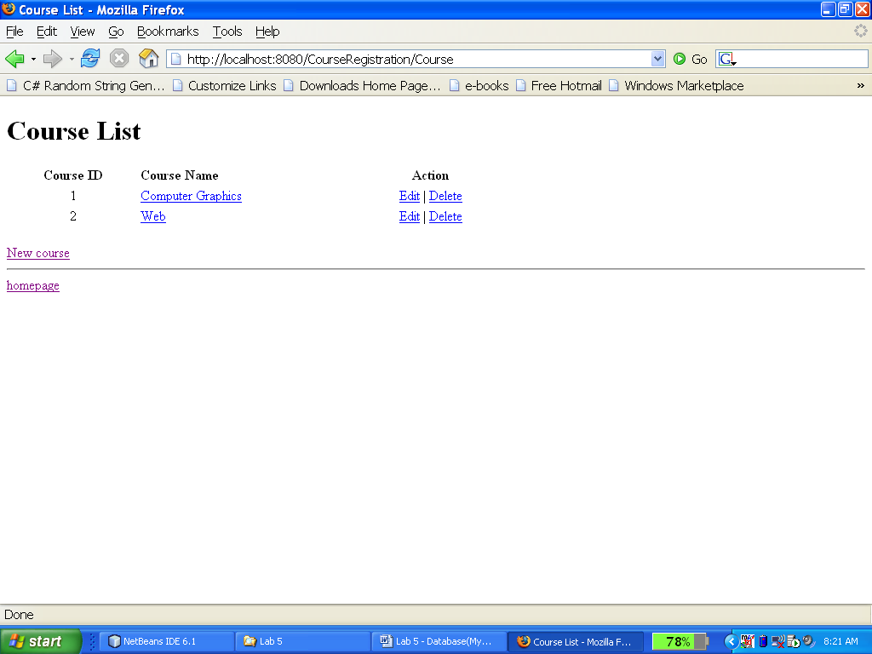
Example: editing and deleting row

Slide 12
Assignment 2 assessment
Will be done on
  November 17th, 2010 for Wednesday afternoon class
  November 19th, 2010 for Friday afternoon class
All absentations without prior notification and unjust reason MUST NOT BE ACCEPTABLE.

Slide 13
Assignment 3
Will be sent by email to all students
Will have the deadline on:
  1:00 PM November 24th, 2010
Submit to me by email
MUST contain [WEB FALL 2010 - LAB] in subject.

Slide 14
Question?

